Slide 1

BIG DATA ANALYTICS
Unit-I
Presented By:
Dr.R.Tamilkodi
Professor
AIML
GIET(A)
Lecture Details:
TOPIC NAME
Big Data Analytics/B.Tech,III-Year /II-Sem.

Slide 2
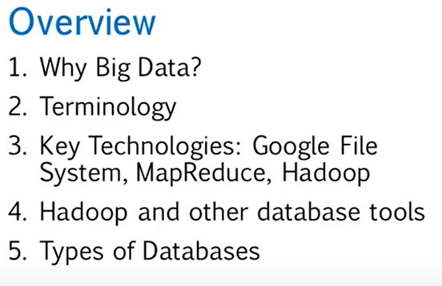
FUNDAMENTALS OF BIG DATA

Slide 3
Introduction
Big Data is a term that is used for denoting the collection of datasets that are large and complex, making it very difficult to process using legacy data processing applications.

Slide 4
Big Data Definition
“Big Data” is data whose scale, diversity, and complexity require new architecture, techniques, algorithms, and analytics to manage it and extract value and hidden knowledge from it…

Slide 5
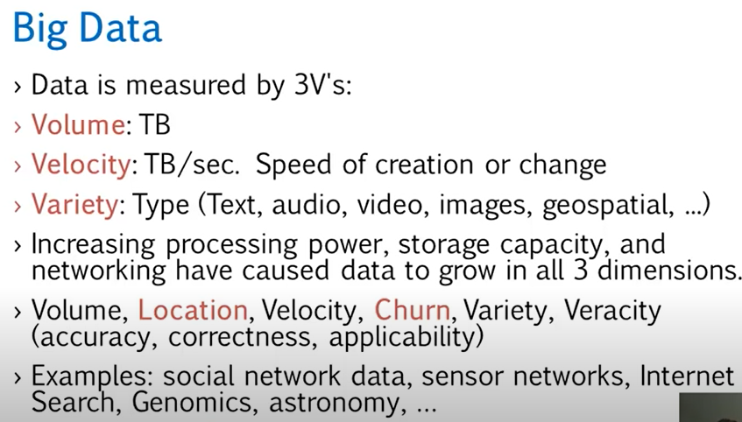

Slide 6
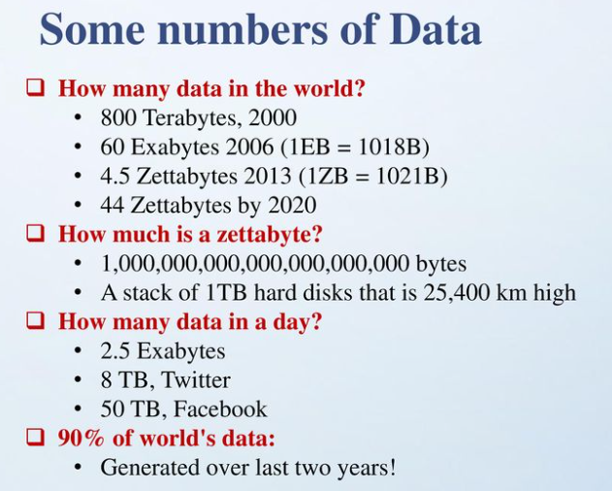

Slide 7
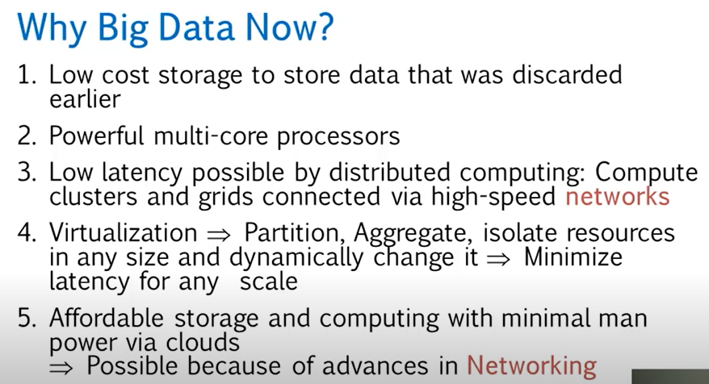

Slide 8
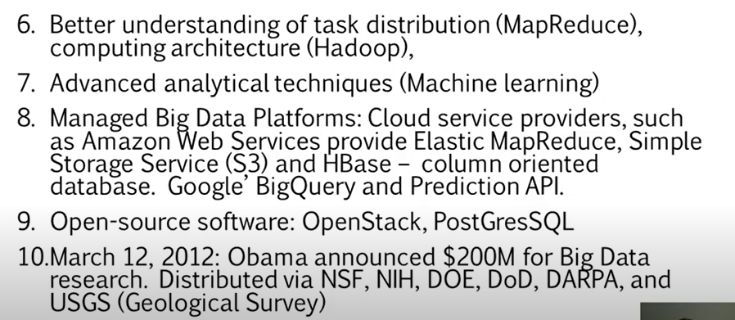

Slide 9
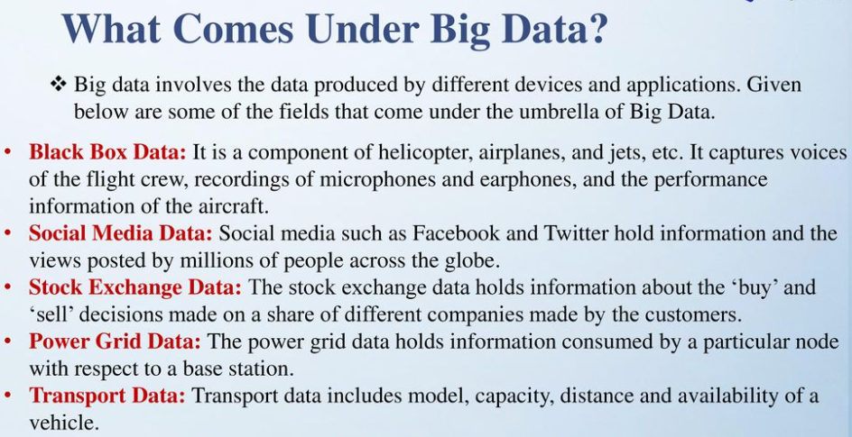

Slide 10
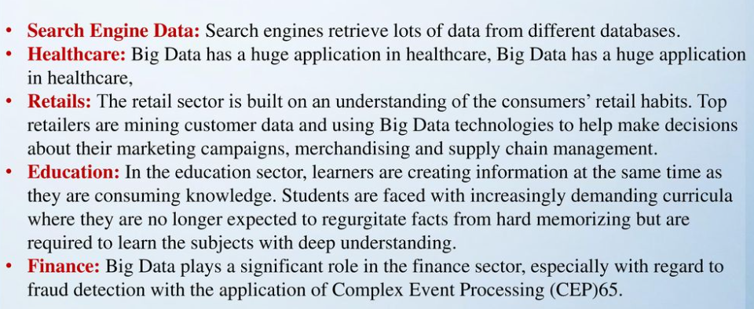

Slide 11
Operational Big Data
Operational Big Data systems provide operational features to run real-time, interactive workloads that ingest and store data.
MongoDB is a top technology for operational Big Data applications with over 10 million downloads of its open source software.
MongoDB is a document database with the scalability and flexibility that you want with the querying and indexing that you need.

Slide 12
Analytical Big Data
Are useful for retrospective, sophisticated analytics of your data.
Hadoop is the most popular example of an Analytical Big Data technology.

Slide 13
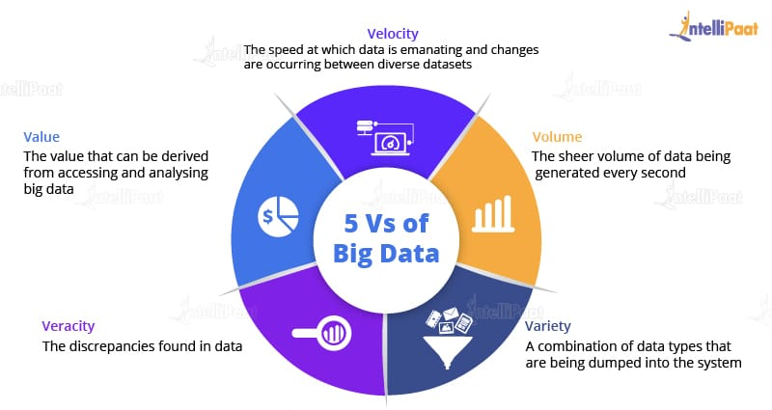

Characteristic of Big Data

Slide 14
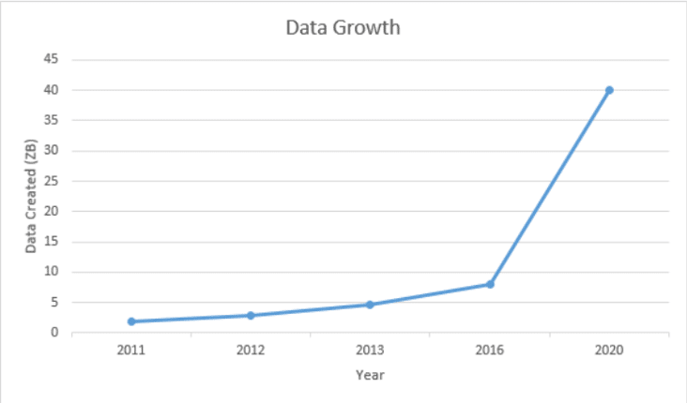
Volume
Data that is tremendously large, the volume of data is rising exponentially.
In 2016, the data created was only 8 ZB and it is expected that, by 2020, the data would rise up to 40 ZB, which is extremely large.

Slide 15
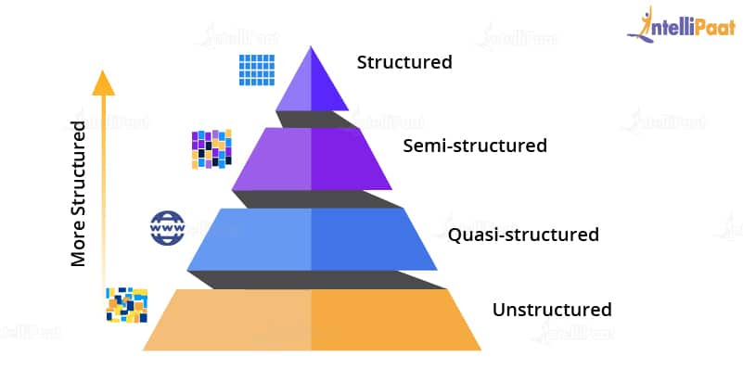
Variety
A reason for this rapid growth of data volume is that the data is coming from different sources in various formats.

Slide 16
Structured Data
Data is present in a structured schema, along with all the required columns. It is in a structured format.
b) Semi-structured Data
Semi-structured data has a structured form but it isn’t defined,
c) Unstructured Data
Data which has an unfamiliar model or structure is categorized as unstructured data.
d) Quasi-structured Data
Data format consists of textual data with inconsistent data formats that can be formatted with effort and time.

Slide 17
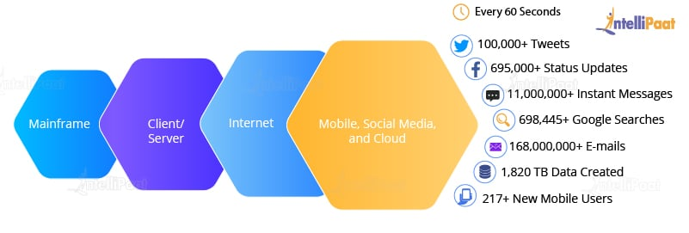
Velocity
The speed of data accumulation also plays a role in determining whether the data is categorized into big data or normal data.

Slide 18
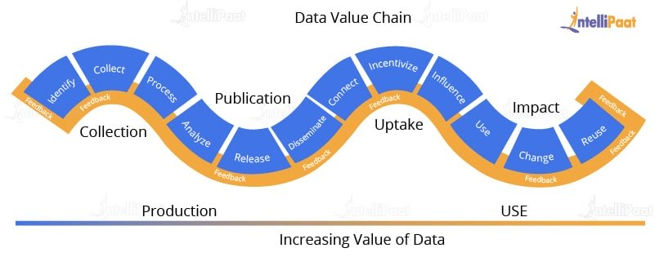
Value
Process to turn raw data into useful data, which deals with a mechanism to bring out the correct meaning out of data.

Slide 19
Veracity
Mining raw data in order to convert them into valuable data. And this process goes on.
Also, there will be uncertainties and inconsistencies in the data.

Slide 20

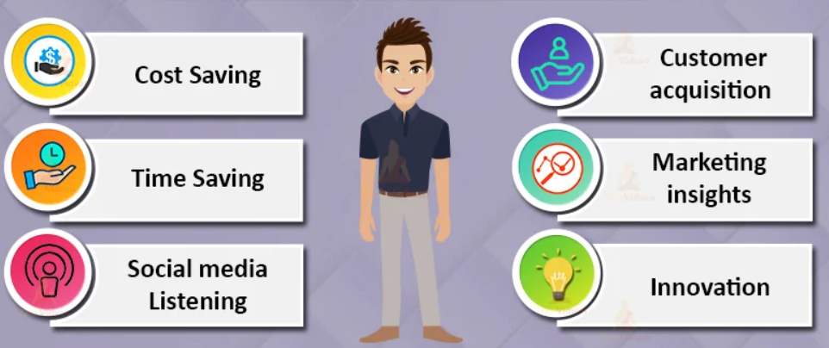

Slide 21
Big Data importance doesn’t revolve around the amount of data a company has.
Its importance lies in the fact that how the company utilizes the gathered data.
Every company uses its collected data in its own way.
More effectively the company uses its data, more rapidly it grows.
The companies in the present market need to collect it and analyze it

Slide 22
1. Cost Savings
Big Data tools like Apache Hadoop, Spark, etc. bring cost-saving benefits to businesses when they have to store large amounts of data. These tools help organizations in identifying more effective ways of doing business.
2. Time-Saving
Real-time in-memory analytics helps companies to collect data from various sources. Tools like Hadoop help them to analyze data immediately thus helping in making quick decisions based on the learnings.

Slide 23
3.Understand the market conditions
Big Data analysis helps businesses to get a better understanding of market situations.
For example, analysis of customer purchasing behavior helps companies to identify the products sold most and thus produces those products accordingly. This helps companies to get ahead of their competitors.
4. Social Media Listening
Companies can perform sentiment analysis using Big Data tools. These enable them to get feedback about their company, that is, who is saying what about the company.
Companies can use Big data tools to improve their online presence.

Slide 24
5. Boost Customer Acquisition and Retention
Customers are a vital asset on which any business depends on. No single business can achieve its success without building a robust customer base.
But even with a solid customer base, the companies can’t ignore the competition in the market.
If we don’t know what our customers want then it will degrade companies’ success.
It will result in the loss of clientele which creates an adverse effect on business growth.
Big data analytics helps businesses to identify customer related trends and patterns. Customer behavior analysis leads to a profitable business.

Slide 25
6. Solve Advertisers Problem and Offer Marketing Insights
Big data analytics shapes all business operations. It enables companies to fulfill customer expectations.
Big data analytics helps in changing the company’s product line.
It ensures powerful marketing campaigns.
7. The driver of Innovations and Product Development
Big data makes companies capable to innovate and redevelop their products.

Slide 26
Types of Big Data
Structured data
Structured data has certain predefined organizational properties and is present in structured or tabular schema, making it easier to analyze and sort.
In addition, thanks to its predefined nature, each field is discrete and can be accessed separately or jointly along with data from other fields.
This makes structured data extremely valuable, making it possible to collect data from various locations in the database quickly.

Slide 27
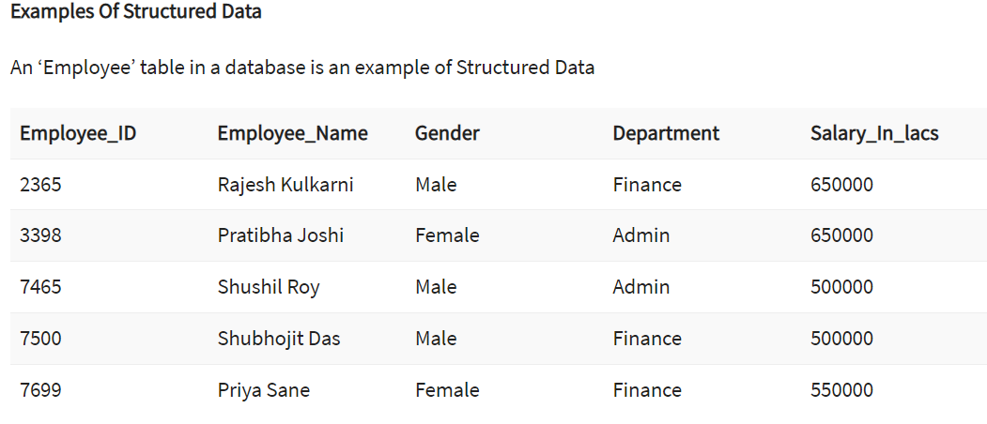

Slide 28
Unstructured data
Unstructured data entails information with no predefined conceptual definitions and is not easily interpreted or analyzed by standard databases or data models.
Unstructured data accounts for the majority of big data and comprises information such as dates, numbers, and facts.
Big data examples of this type include video and audio files, mobile activity, satellite imagery, and No-SQL databases, to name a few.
Photos we upload on Facebook or Instagram and videos that we watch on YouTube or any other platform contribute to the growing pile of unstructured data.

Slide 29
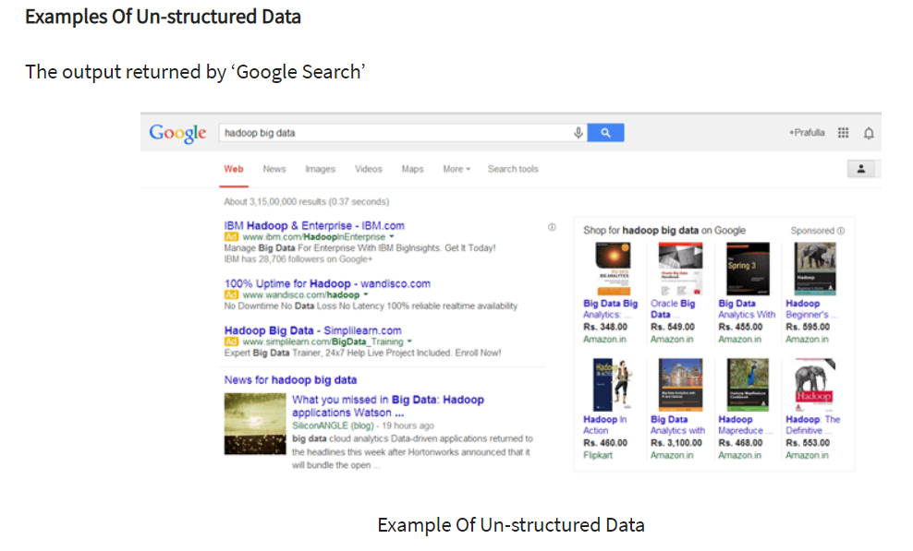

Slide 30
Semi-structured data
Semi-structured data is a hybrid of structured and unstructured data.
This means that it inherits a few characteristics of structured data but nonetheless contains information that fails to have a definite structure and does not conform with relational databases or formal structures of data models.
For instance, JSON and XML are typical examples of semi-structured data.

Slide 31
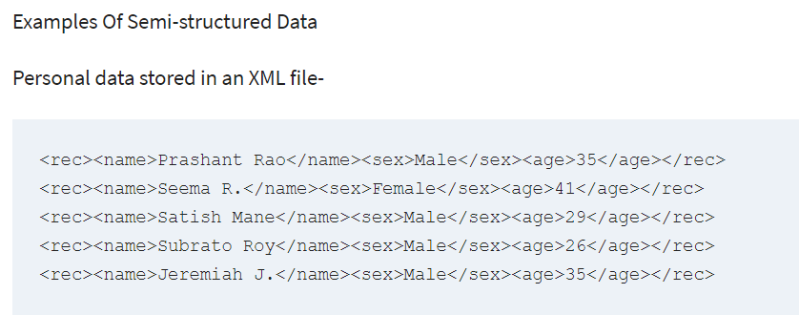

Slide 32
Sources of Big Data
A significant part of big data is generated from three primary resources:
Machine data
Social data, and
Transactional data.

Slide 33
1. Machine Data
Machine data is automatically generated, either as a response to a specific event or a fixed schedule.
It means all the information is developed from multiple sources such as smart sensors, SIEM logs, medical devices and wearables, road cameras, IoT devices, satellites, desktops, mobile phones, industrial machinery, etc.
These sources enable companies to track consumer behaviour.
Data extracted from machine sources grow exponentially along with the changing external environment of the market.

Slide 34
2. Social Data
It is derived from social media platforms through tweets, retweets, likes, video uploads, and comments shared on Facebook, Instagram, Twitter, YouTube, Linked In etc.
The extensive data generated through social media platforms and online channels offer qualitative and quantitative insights on each crucial facet of brand-customer interaction.
Social media data spreads like wildfire and reaches an extensive audience base. It gauges important insights regarding customer behaviour, their sentiment regarding products and services.

Slide 35
3. Transactional Data
The transactional data is information gathered via online and offline transactions during different points of sale.
The data includes vital details like transaction time, location, products purchased, product prices, payment methods, discounts/coupons used, and other relevant quantifiable information related to transactions.
The sources of transactional data include:
Payment orders
Invoices
Storage records and
E-receipts

Slide 36
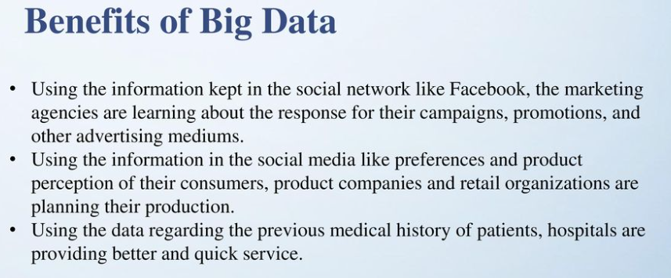

Slide 37
Benefits of using Big Data Analytics
The following are some of the benefits of using big data analytics:
Analysis of large volumes of data from disparate sources in a variety of forms and kinds in a timely manner
Quickly making well-informed judgments for successful strategizing to enhance the supply chain, logistics, and other tactical decision-making sectors
Savings due to the increased efficiency and optimization of business processes
More informed risk management techniques based on large data sample sizes
Greater knowledge of consumer behavior, demands, and sentiment can result in better product development data and strategic management processes

Slide 38
Real-Time Benefits of Big Data
Big Data analytics has expanded its roots in all the fields.
This results in the use of Big Data in a wide range of industries including Finance and Banking, Healthcare, Education, Government, Retail, Manufacturing, and many more.
There are many companies like Amazon, Netflix, Spotify, LinkedIn, Swiggy,etc which use big data analytics. Banking sectors make the maximum use of Big Data Analytics.
Education sector is also using data analytics to enhance students’ performance as well as making teaching easier for instructors.
Big Data analytics help retailers from traditional to e-commerce to understand customer behaviour and recommend products as per customer interest.
This helps them in developing new and improved products which help the firm enormously.

Slide 39
Applications of Big Data Analytics
Customer Acquisition and Retention: Customer information helps tremendously in marketing trends, through data-driven actions, to increase customer satisfaction. For example, personalization engines for Netflix, Amazon, and Spotify help with improved customer experiences and gaining customer loyalty.
Targeted Ads: Personalized data about interaction patterns, order history, and product page viewing history can help immensely to create targeted ad campaigns for customers on a larger scale and at the individual level.
Product Development: It can generate insights on development decisions, product viability, performance measurements, etc., and direct improvements that positively serve the customers.
Price Optimization: Pricing models can be modeled and used by retailers with the help of diverse data sources to maximize revenues.

Slide 40
Supply Chain and Channel Analytics: Predictive analytical models help with B2B supplier networks, preemptive replenishment, route optimizations, inventory management, and notification of potential delays in deliveries.
Risk Management: It helps in the identification of new risks with the help of data patterns for the purpose of developing effective risk management strategies.
Improved Decision-making: The insights that are extracted from the data can help enterprises make sound and quick decisions.

Slide 41
Big Data Applications
Monitor premature infants to alert when interventions is needed
Predict machine failures in manufacturing
Prevent traffic jams, save fuel, reduce pollution

Slide 42
BigData Applications
Big Data in Retail
Big Data in Healthcare
Big Data in Education
Big Data in E-commerce
Big Data in Media and Entertainment
Big Data in Finance
Big Data in Travel Industry
Big Data in Telecom
Big Data in Automobile

Slide 43
Big data challenges
In connection with the processing capacity issues, designing a big data architecture is a common challenge for users.
Big data systems must be tailored to an organization's particular needs, a DIY undertaking that requires IT and data management teams to piece together a customized set of technologies and tools.
Deploying and managing big data systems also require new skills compared to the ones that database administrators and developers focused on relational software typically possess.
Both of those issues can be eased by using a managed cloud service, but IT managers need to keep a close eye on cloud usage to make sure costs don't get out of hand.

Slide 44
Also, migrating on-premises data sets and processing workloads to the cloud is often a complex process.
Other challenges in managing big data systems include making the data accessible to data scientists and analysts, especially in distributed environments that include a mix of different platforms and data stores.
To help analysts find relevant data, data management and analytics teams are increasingly building data catalogs that incorporate metadata management and data lineage functions.
The process of integrating sets of big data is often also complicated, particularly when data variety and velocity are factors.

Slide 45
Accessibility of Data: With larger volumes of data, storage and processing become a challenge.
Big data should be maintained in such a way that it can be used by less-experienced data scientists and data analysts as well.
Data Quality Maintenance: With high volumes of data from disparate sources and in different formats, the proper management of data quality requires considerable time, effort, and resources.
Data Security: The complexity of big data systems poses unique challenges when it comes to security.
It can be a complex undertaking to properly address such security concerns within complicated big data ecosystems.

Slide 46
Choosing the Right Tools: Choosing big data analytics tools from the wide range that is available in the market can be quite confusing. One should know how to select the best tool that aligns with user requirements and organizational infrastructure.
Supply-demand Gap in Skills: With a lack of data analytics skills in addition to the high cost of hiring experienced professionals, enterprises are finding it hard to meet the demand for skilled big data analytics professionals.

